Slide 1
Tools

Slide 2
Plan
Wi-Fi (WEP, WPA, WPA2)
Wireshark
openssl
Burp Suite, OWASP ZAP

Slide 3
Wi-Fi
Use WPA2, CCMP
WEP and WPA are outdated
Wireshark and aircrack-ng can sniff straffic

Slide 4
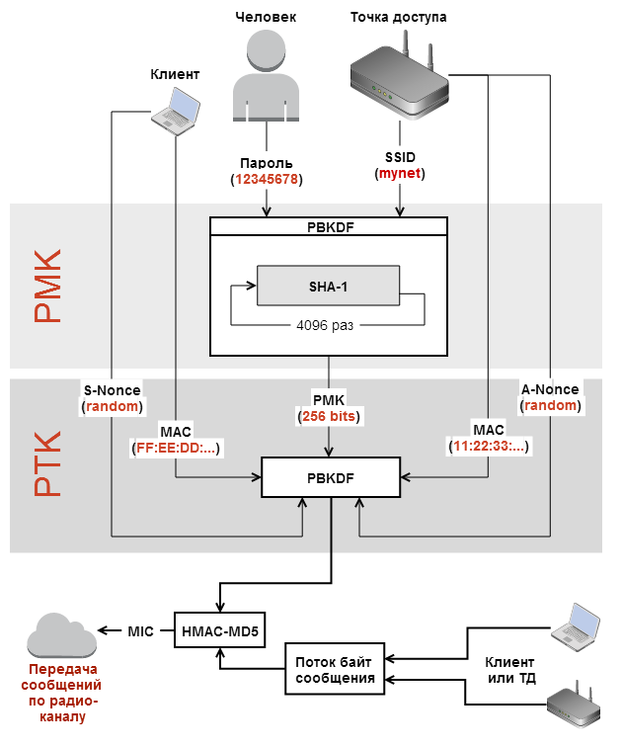
Wi-Fi
Notes:
https://www.youtube.com/watch?v=UK4zzSVXqiI
https://habr.com/ru/post/226431/
https://habr.com/ru/post/225483/
https://www.youtube.com/watch?v=Ra0dGPYScLQ
PMK (Pairwise Master Key — главный парный ключ)
PTK (Pairwise Transient Key — кратковременный парный ключ)

Slide 5
openssl
Check server certificate
openssl s_client -connect parallels.com:443
openssl x509 -noout -text -in cert.pem
Encrypt file
openssl des-ecb -in file -out file.enc
Generate self-signed certificate
openssl genrsa -out root.key 4096
openssl req -new -x509 -sha256 -days 365 \
-key root.key -out root.crt -utf8 \
-subj ’/CN=SSL_Test_CA'

Slide 6
Tools
Network
Wireshark, tcpdump
nmap, masscan
Hex edit/view
hexdump, HxD, WinHex
Wireless
airckrack-ng

Slide 7
Tools
HTTP traffic inspection
Burp Suite
OWASP ZAP
SSH and TLS checkers
https://github.com/mozilla/ssh_scan
https://github.com/mozilla/tls-observatory
https://www.ssllabs.com/ssltest
https://securityheaders.com/

Slide 8
Tools
AFL
libFuzzer
Notes:
https://habr.com/ru/company/dsec/blog/435644/ - AFL
https://github.com/google/fuzzing/blob/master/docs/structure-aware-fuzzing.md

Slide 9
Tools
Reverse engineering
Radare2, IDA (including free versions)
Monitoring
Sysinternals Suite
Other
strings, dd

Slide 10
Thank you!

